Slide 1
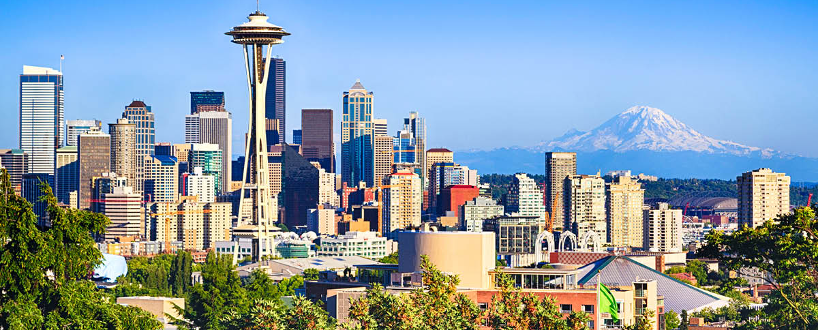
King County Housing
Buying a house for Larry Sanders & Sons

Slide 2
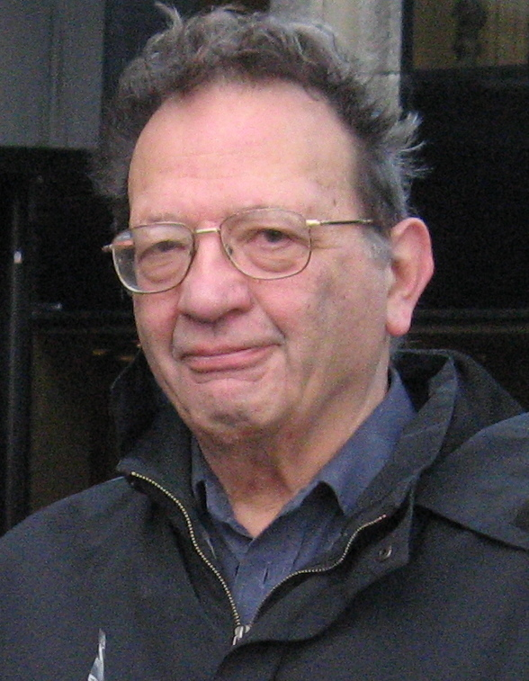


Larry Sanders
Brother
Profile:
Has limited budget
Has kids
Wants a nice & isolated but central neighborhood without other pesky kids
Wants a house with waterfront

Slide 3
Approach
Pick relevant features based on client and hypotheses
Examine data types and check for missing values
Check correlations (high-level overview)
Create new features (e.g. price/sqft, grade/sqft)
Remove extreme and impute missing values
Imputed waterfront feature with Scikit-Learn’s KNNImputer using lat/long
Conduct anaylsis on variables of interest, test hypotheses
Gain insights and make recommendations

Slide 4
Inquiry of interest | Reason | Variables
Effect of house size on price | Larry wants a larger house for him and his kids, but ain’t got the cash | Price, house size (sqft_living)

Slide 5
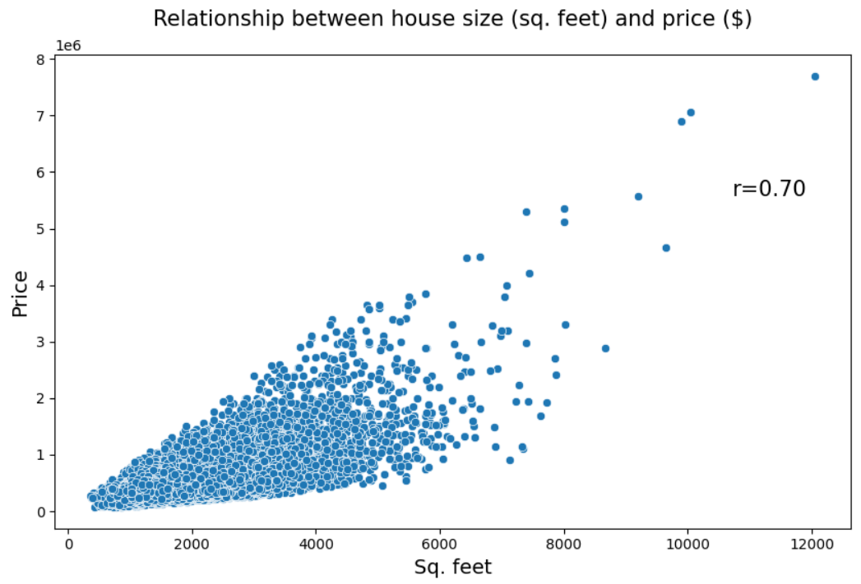
Effect of house size on price
Insight:
The client might able to afford some of the more spacious houses due to higher price ranges.

Slide 6
Inquiry of interest | Reason | Variables
Effect of location of price | Larry wants to live centrally, but not too centrally. Such areas tend to be more expensive | Price, price/sqft, zipcode, lat/long

Slide 7
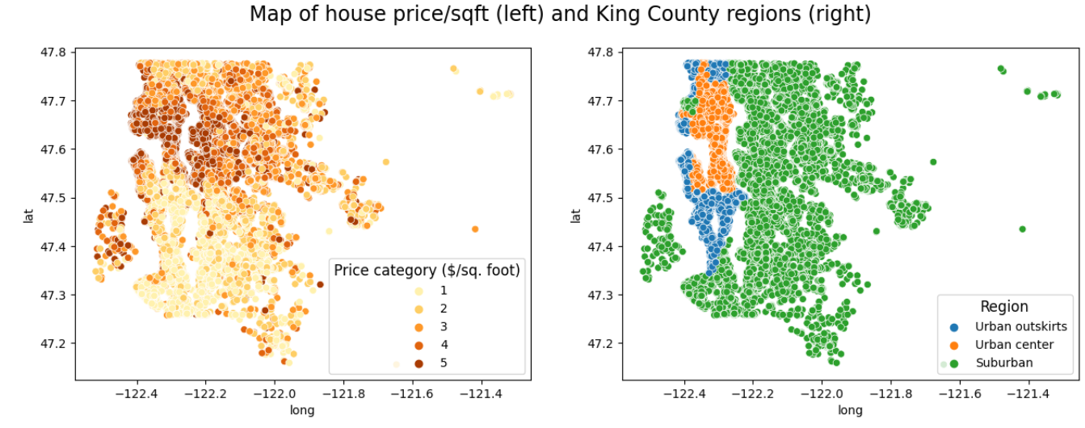
Effect of location of price/sq. foot

Slide 8
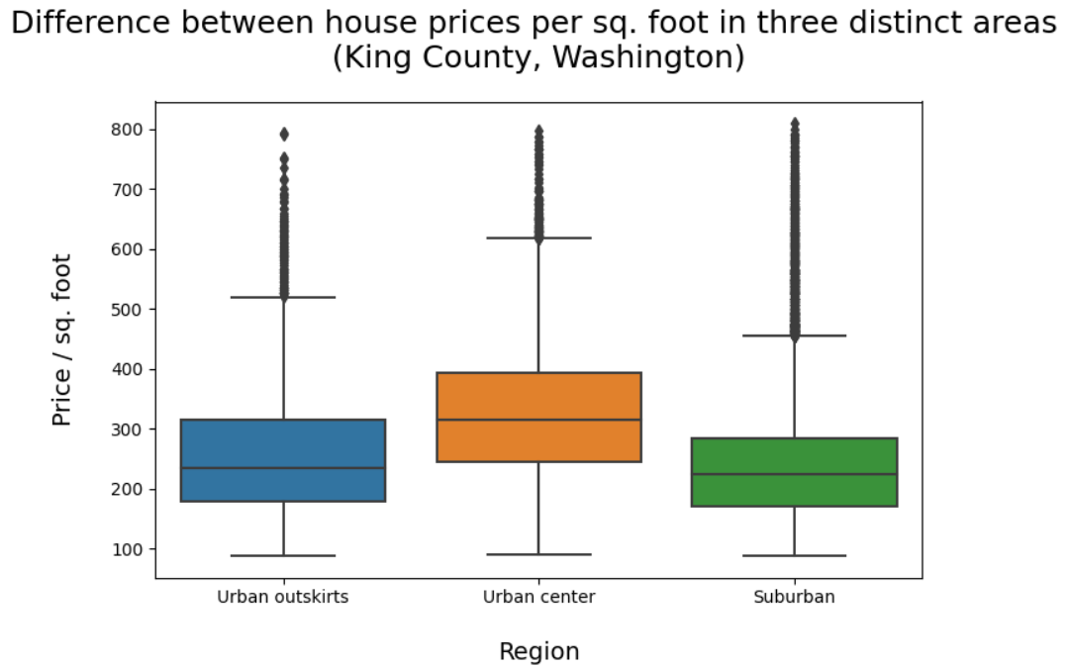
Insight:
The client might able to afford some of the more spacious houses.
A lot of the affordable houses seem, however, to be concentrated in suburban areas, which the client does not prefer.
Recommendation:
Client should primarily look at houses at Seattle’s periphery where prices are still affordable.
Urban outskirts | Urban center | Suburban
235 $/sqft | 315 $/sqft | 224 $/sqft

Slide 9
Inquiry of interest | Reason | Variables
Effect of waterfront on price | Larry wants a waterfront house, but they are not common and tend to be pricey | Price, price/sqft, waterfront, location features

Slide 10
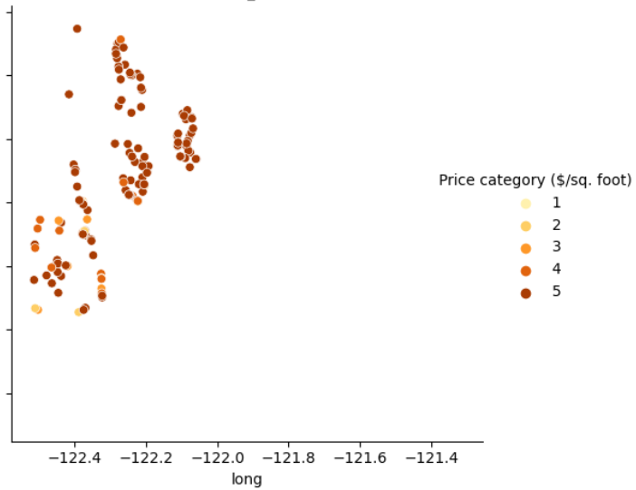
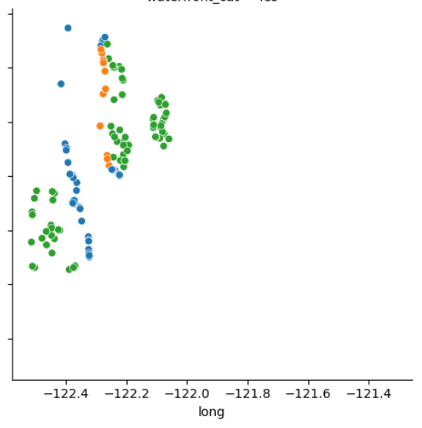
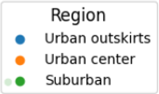
Effect of waterfront on price by region

Slide 11
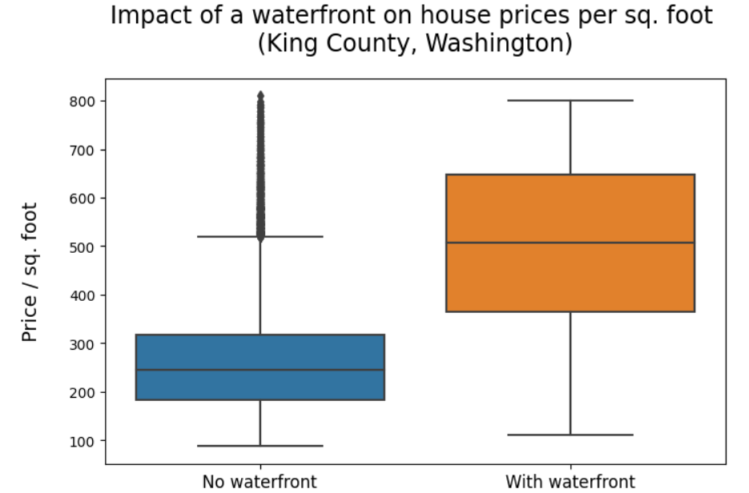
Insight:
The vast majority of houses with a waterfont are most likely out of the client's price range.
Recommendation:
There do exist some not overly expensive options at the outskirts towards the south-western part of Seattle.
Still, the client should reconsider life choices.
No Waterfront | Waterfront
244 $/sqft | 507 $/sqft

Slide 12
Inquiry of interest | Reason | Variables
Areas with large avg. lot size in local neighbourhood | Larry wants a more isolated life, which areas with larger lot sizes tend to offer | Lot size of 15 closest neighbours, location features

Slide 13
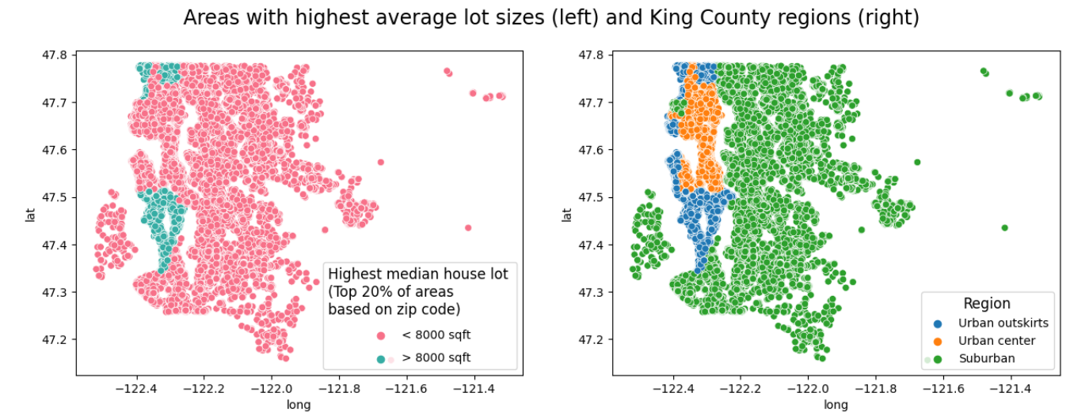
Areas with largest average lot sizes

Slide 14
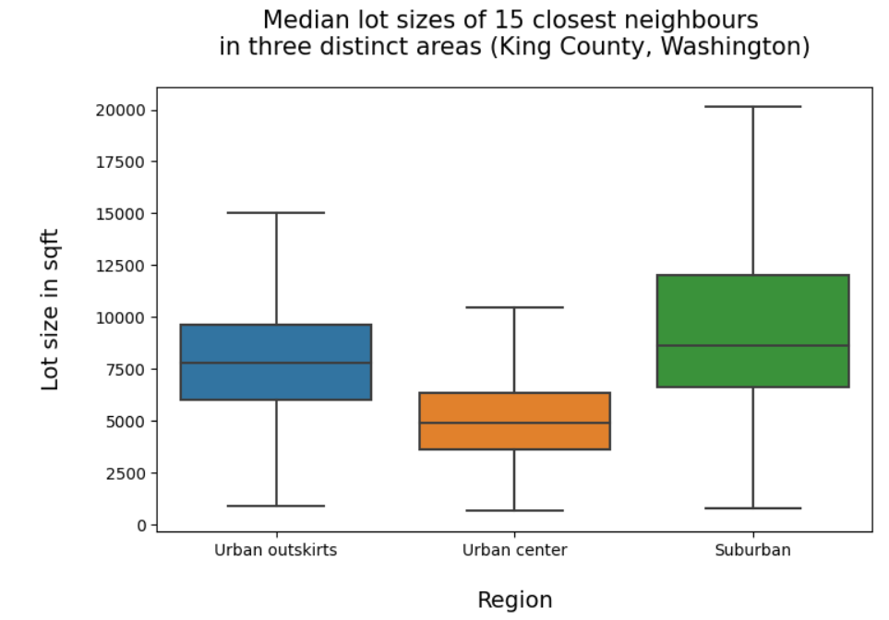
Insight:
The larger the general lot size in a neighbourhood, the more quiet and less busy it is.
Recommendation:
Most of Seattle's peripheral areas seem to provide a good mix between isolated, yet urban neighbourhoods.
Urban outskirts | Urban center | Suburban
7800 sqft | 4877 sqft | 8610 sqft

Slide 15
Inquiry of interest | Reason | Variables
Areas with small avg. house size in local neighbourhood | Larry wants no kids around, the smaller the house sizes in local neighbourhood, the fewer families | House size of 15 closest neighbours, location features

Slide 16
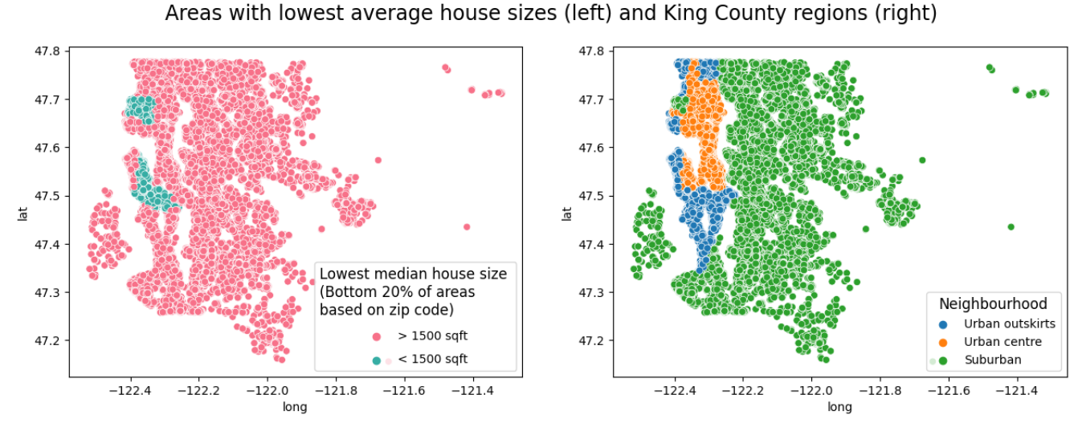
Areas with lowest average house sizes

Slide 17
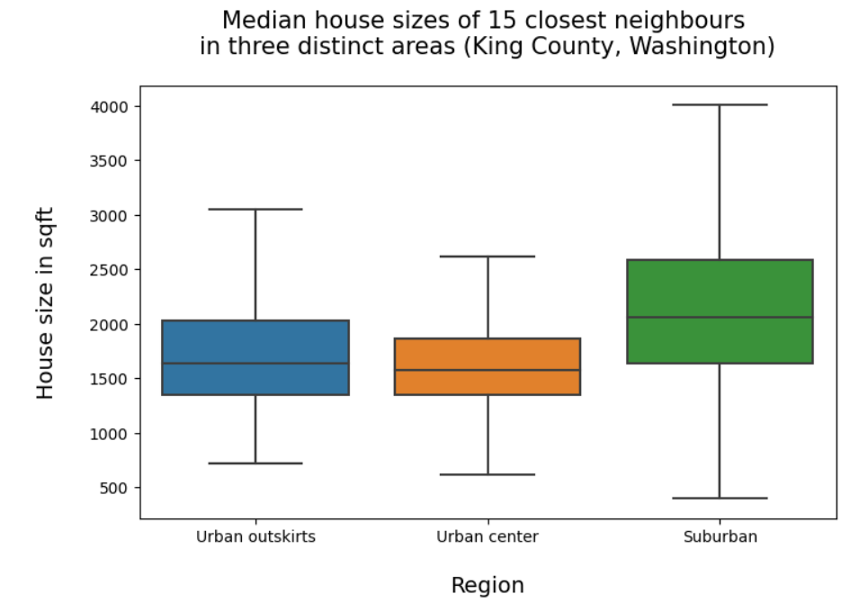
Insight:
While most areas with the lowest median house size seem to be concentrated in Seattle's center, there are still a few neighbourhoods located on the city outskirts that seem to have relatively small housing units.
Recommendation:
Considering how prices in Seattle’s periphery tend to be lower, these neighbourhoods can be an attractive solution for the client.
In particular the northeast and parts of the southern outskirts.
Urban outskirts | Urban center | Suburban
1640 sqft | 1570 sqft | 2060 sqft

Slide 18
Zip codes to consider
Zip codes | Avg. house size (sqft) | Bedrooms | Price ($/sqft) | Median neighbour house size (sqft) | Median neighbour lot size (sqft) | Grade | Waterfront
98146 | 1490 | 3 | 202 | 1440 | 8100 | 7 | If he’s lucky
98166 | 1930 | 3 | 212 | 1850 | 10751 | 7 | If he’s lucky

Slide 19


Thank you, Larry...
...and thank you Bernie!
God bless

